Slide 1
RAID Framework (Risk, Assumptions, Issues, Dependencies)
The RAID framework is a project management tool used to track and manage four key aspects of a project:
Risks
Assumptions
Issues
Dependencies

Slide 2
1. Risks
What are Risks?
Potential events or conditions that could negatively impact the project's success if they occur.
Examples:
Technical Challenges: The chosen technology might not perform as expected.
Resource Constraints: Limited availability of team members or budget cuts.
Scope Changes: Client requests additional features mid-project, affecting timelines.

Slide 3
2. Assumptions
What are Assumptions?
Things considered true without definitive proof, forming the basis for project planning.
Examples:
Resource Availability: Assuming key team members will be available throughout the project.
Stakeholder Participation: Believing that stakeholders will provide timely feedback.
Market Conditions: Expecting that market trends will remain stable.

Slide 4
3. Issues
What are Issues?
Problems that have already occurred and need immediate attention.
Examples:
Technical Glitches: Software bugs causing delays.
Team Conflicts: Disagreements impacting collaboration.
Vendor Delays: Third-party suppliers failing to deliver on time.

Slide 5
4. Dependencies
What are Dependencies?
Tasks or activities that rely on the completion of others.
Examples:
Task Sequencing: Design must be approved before development starts.
External Deliverables: Waiting on a client's data to proceed.
Resource Sharing: Two projects needing the same specialized equipment.

Slide 6
The RAID framework is a structured approach in project management to systematically handle Risks, Assumptions, Issues, and Dependencies. For each of these components, the following processes are applied:
Identification
Mitigation
Monitoring
Management

Slide 7
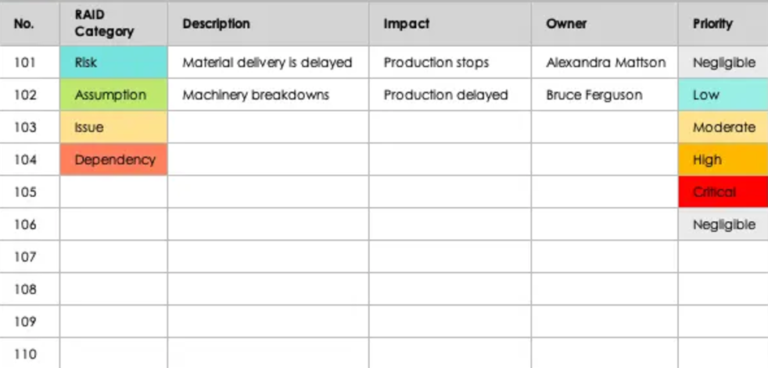
1. Identification
Definition:
Identification is the process of discovering and documenting all potential Risks, Assumptions, Issues, and Dependencies that could affect the project.
Purpose:
To have a comprehensive understanding of all factors that might influence the project's success or pose challenges during its execution.
General Steps:
Data Gathering: Collect information from various sources such as team brainstorming sessions, stakeholder interviews, and historical data from past projects.
Documentation: Record all identified elements in a structured format, like a RAID log or register.
Analysis: Assess the nature and context of each element to understand its potential impact on the project.

Slide 8
Application to RAID Components:
Risks: Identifying potential future events that could negatively affect the project.
Assumptions: Recognizing statements taken to be true without proof, which underlie the project plan.
Issues: Pinpointing current problems that need immediate attention.
Dependencies: Identifying tasks or external factors that the project relies on.

Slide 9
2. Mitigation
Definition:
Mitigation involves developing strategies and actions to reduce or eliminate the negative impact of identified Risks, Assumptions, Issues, and Dependencies.
Purpose:
To proactively address potential challenges, thereby minimizing their adverse effects on the project.
General Strategies:
Prioritization: Determine which elements have the highest potential impact and address them first.
Action Planning: Develop specific actions to reduce the likelihood or impact of negative events.
Resource Allocation: Assign necessary resources (time, budget, personnel) to implement mitigation strategies.

Slide 10
Application to RAID Components:
Risks: Implementing risk avoidance, reduction, transfer, or acceptance strategies.
Assumptions: Validating assumptions or creating contingency plans if they prove false.
Issues: Resolving current problems through immediate action or escalation.
Dependencies: Adjusting schedules or plans to minimize the impact of dependency delays.

Slide 11
3. Monitoring
Definition:
Monitoring is the ongoing process of tracking identified Risks, Assumptions, Issues, and Dependencies to observe any changes in their status or impact.
Purpose:
To stay informed about the current state of these elements and to detect any new developments promptly.
General Practices:
Regular Reviews: Schedule periodic check-ins to assess the status of each element.
Updates to Logs: Keep the RAID log current with any changes or new information.
Communication: Maintain open lines of communication with team members and stakeholders for timely updates.
Performance Indicators: Use Key Performance Indicators (KPIs) to measure and monitor impact levels.

Slide 12
Application to RAID Components:
Risks: Tracking risk triggers and updating risk assessments.
Assumptions: Re-evaluating assumptions as the project progresses to ensure they remain valid.
Issues: Monitoring the resolution progress of ongoing issues.
Dependencies: Keeping an eye on dependent tasks to ensure they are on schedule.

Slide 13
Management
It means taking care of Risks, Assumptions, Issues, and Dependencies throughout the entire project. It includes all the activities needed to keep these elements under control and ensure the project stays on track.
Purpose:
To ensure these elements are controlled in a way that minimizes negative impacts and enhances the likelihood of project success.
Key Management Activities:
Planning: Establish procedures and policies for managing RAID components.
Decision-Making: Make informed decisions based on the current status and potential impact of each element.
Responsibility Assignment: Designate owners for managing specific risks, assumptions, issues, or dependencies.
Adjustments: Modify project plans as necessary to respond to changes in RAID elements.
Reporting: Provide regular updates to stakeholders on the status and management of RAID components.

Slide 14
Application to RAID Components:
Risks: Implementing a risk management plan that includes identification, analysis, response planning, and control.
Assumptions: Managing assumptions by continuously validating them and adjusting plans accordingly.
Issues: Establishing an issue management process for prompt resolution.
Dependencies: Coordinating and aligning tasks and schedules to effectively manage dependencies.

